Slide 1
Homework Presentation Week 2—Datasets May 20, 2019
Mark A. Russo

Slide 2
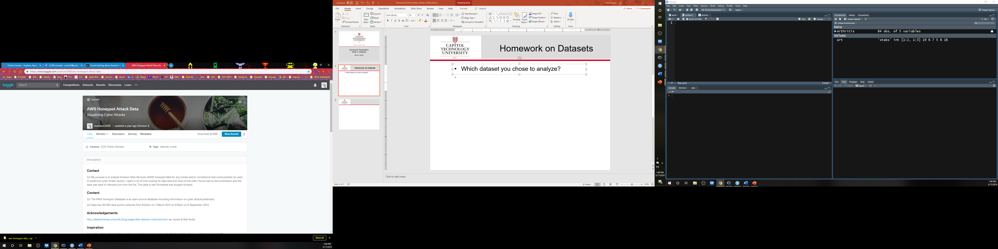

Homework on Datasets
Which dataset you chose to analyze?
(2013) AWS Honeypot Attack Data
Kaggle. (2019). Homepage. Retrieved from https://www.kaggle.com
A honeypot is a computer or computer system intended to mimic likely targets of cyberattacks. It can be used to detect attacks or deflect them from a legitimate target. It can also be used to gain information about how cybercriminals operate.
Norton. (2019). What is a honeypot? [Blog post]. Retrieved from https://us.norton.com/internetsecurity-iot-what-is-a-honeypot.html

Slide 3
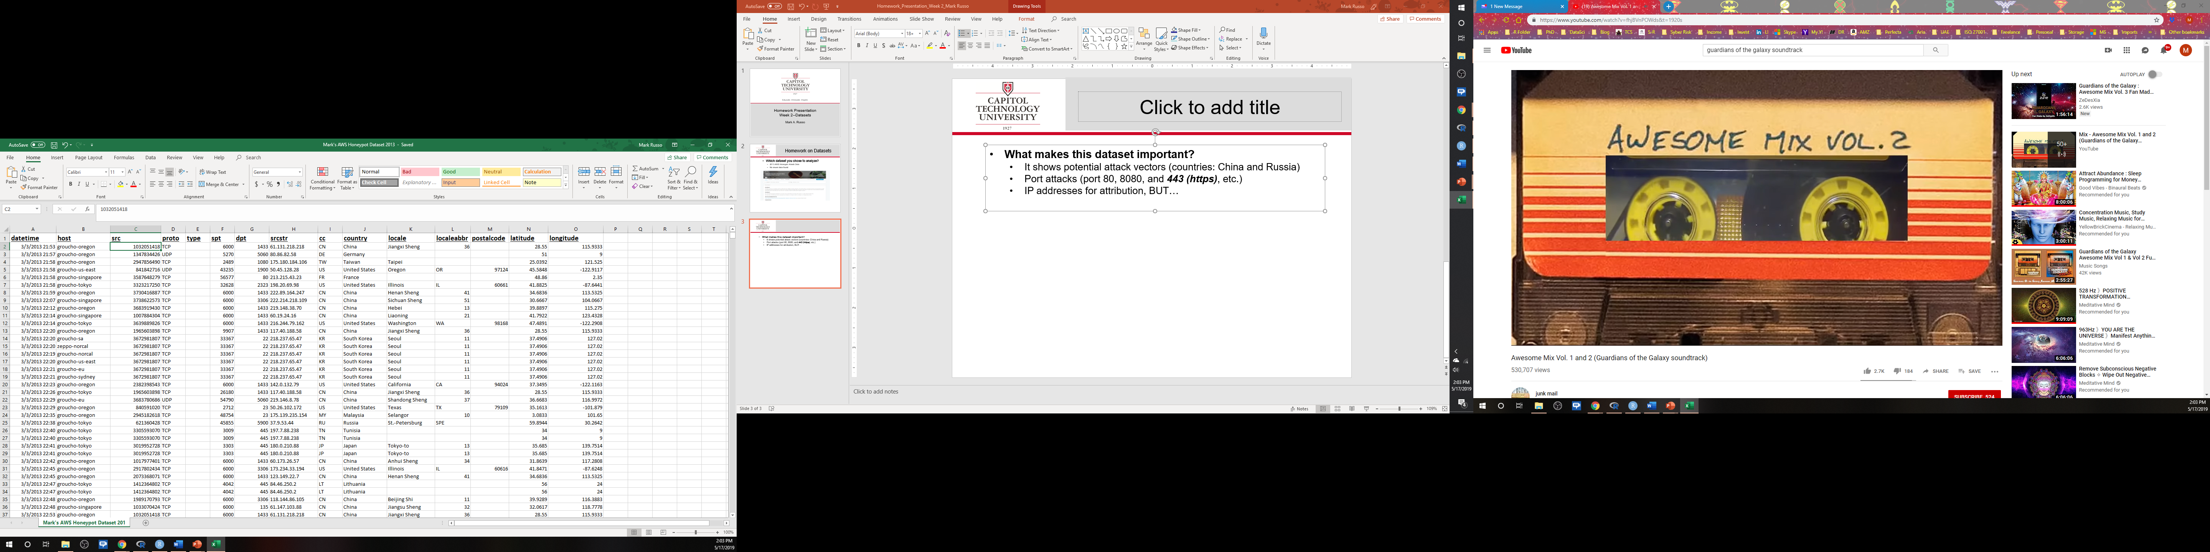
Homework on Datasets (cont.)
What makes this dataset important?
It shows potential attack vectors (countries: China and Russia based IP address)
Port attacks (port 80, 8080, and 443 (https), etc.)
IP addresses for attribution, BUT…
Could “feed” an Artificial Neural Network(ANN) with less-than friendly interlopers AKA “hackers”

Slide 4
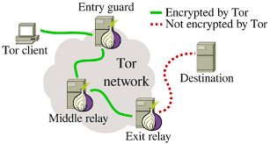
Homework on Datasets (cont.)
What research questions are you asking?
Can I use this to supplement an ANN PREDICTIVE ANALYTICS model/framework to better respond to cyberthreats REAL-TIME?
How many more HONEYPOT datasets would be enough? (Rule of 5? What’s the total “population” of honeypots in the US?)
Approaching population the wrong way; a whole sampling of active hackers
Are other data fields needed? (MAC addresses, other IP bounces, known VPN/proxy/TOR addresses, known whitelists/ blacklists)
IP Address 1234
Address “seen” IP Address 9834
IP Address 5678
The Conversation. (2016, May 17). Securing web browsing: Protecting the Tor network. Retrieved from http://theconversation.com/securing-web-browsing- protecting-the-tor-network-56840
IP Address 9834

Slide 5
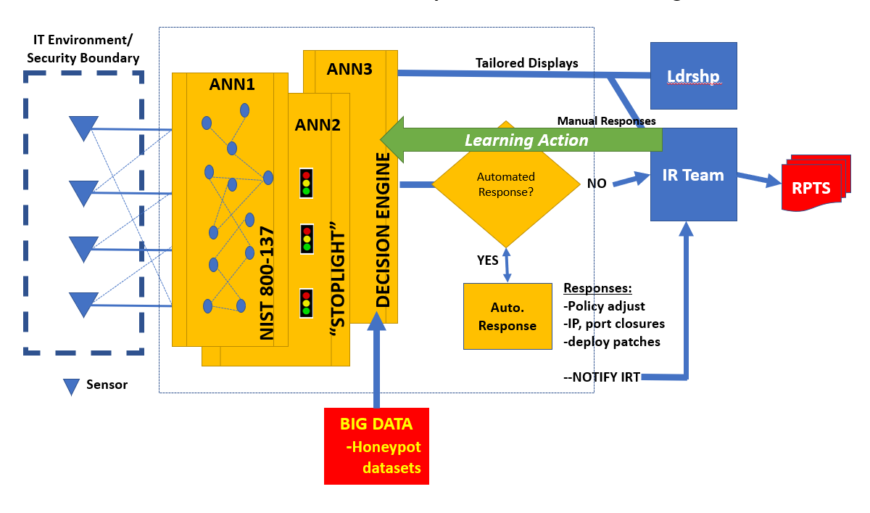
Homework on Datasets (cont.)
What research questions are you asking? (cont.)
Good vs. Bad Guy?

Slide 6
Homework on Datasets (cont.)
How the dataset applies to a specific business decision?
Improve predictive capacity and respond to cyber-threats in real-time (both human and automated)
Leverages evolving Big Data capabilities
Why your analysis would be important and/or how it closes gaps in knowledge?
Provide a RT vice NRT capability
Would close a gap in limited academic study in this area…however, private-sector may be exploring
(a known-unknown)

Slide 7
Data Importing Methods

Slide 8
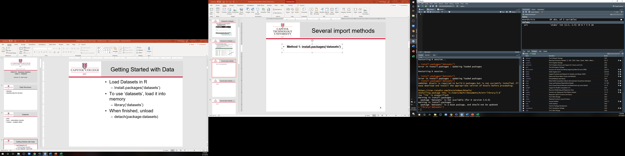
Import method—homework package
Method 1: install.packages(‘datasets’)

Slide 9
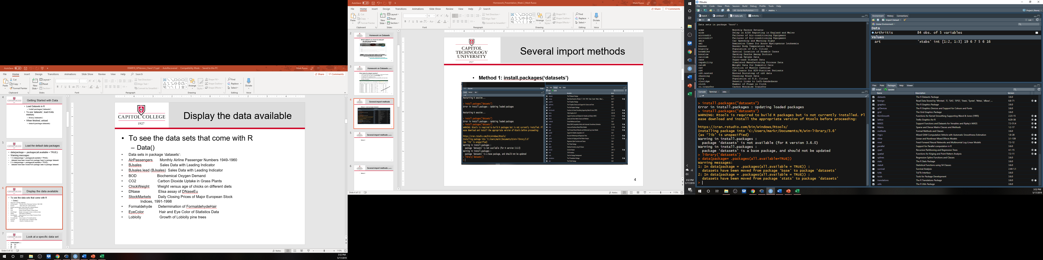
“Load the default data packages”

Slide 10
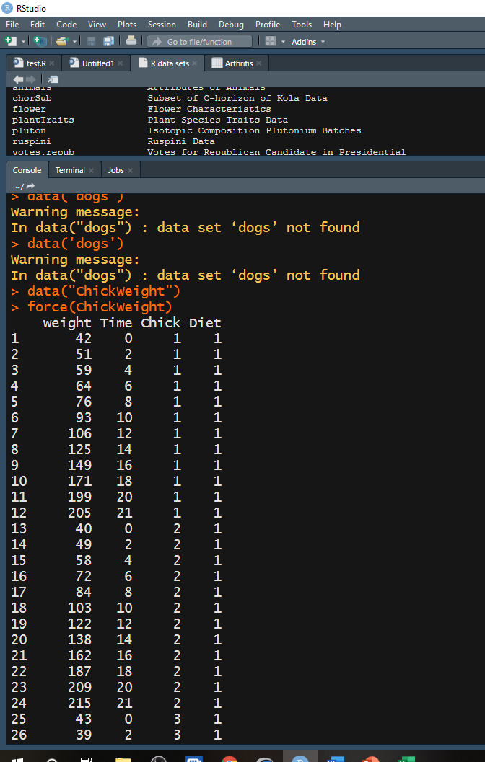
“Look at a specific data set”
From Console: “Chicken weight” data set

Slide 11
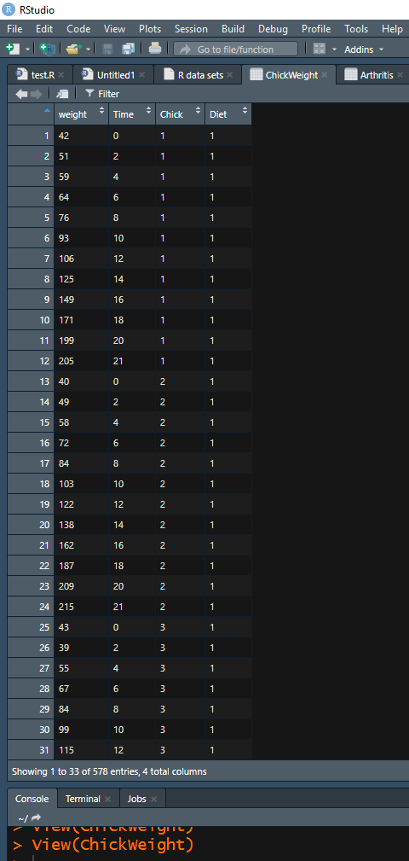
Pane layout
From Pane view:
“Chicken weight” data set

Slide 12
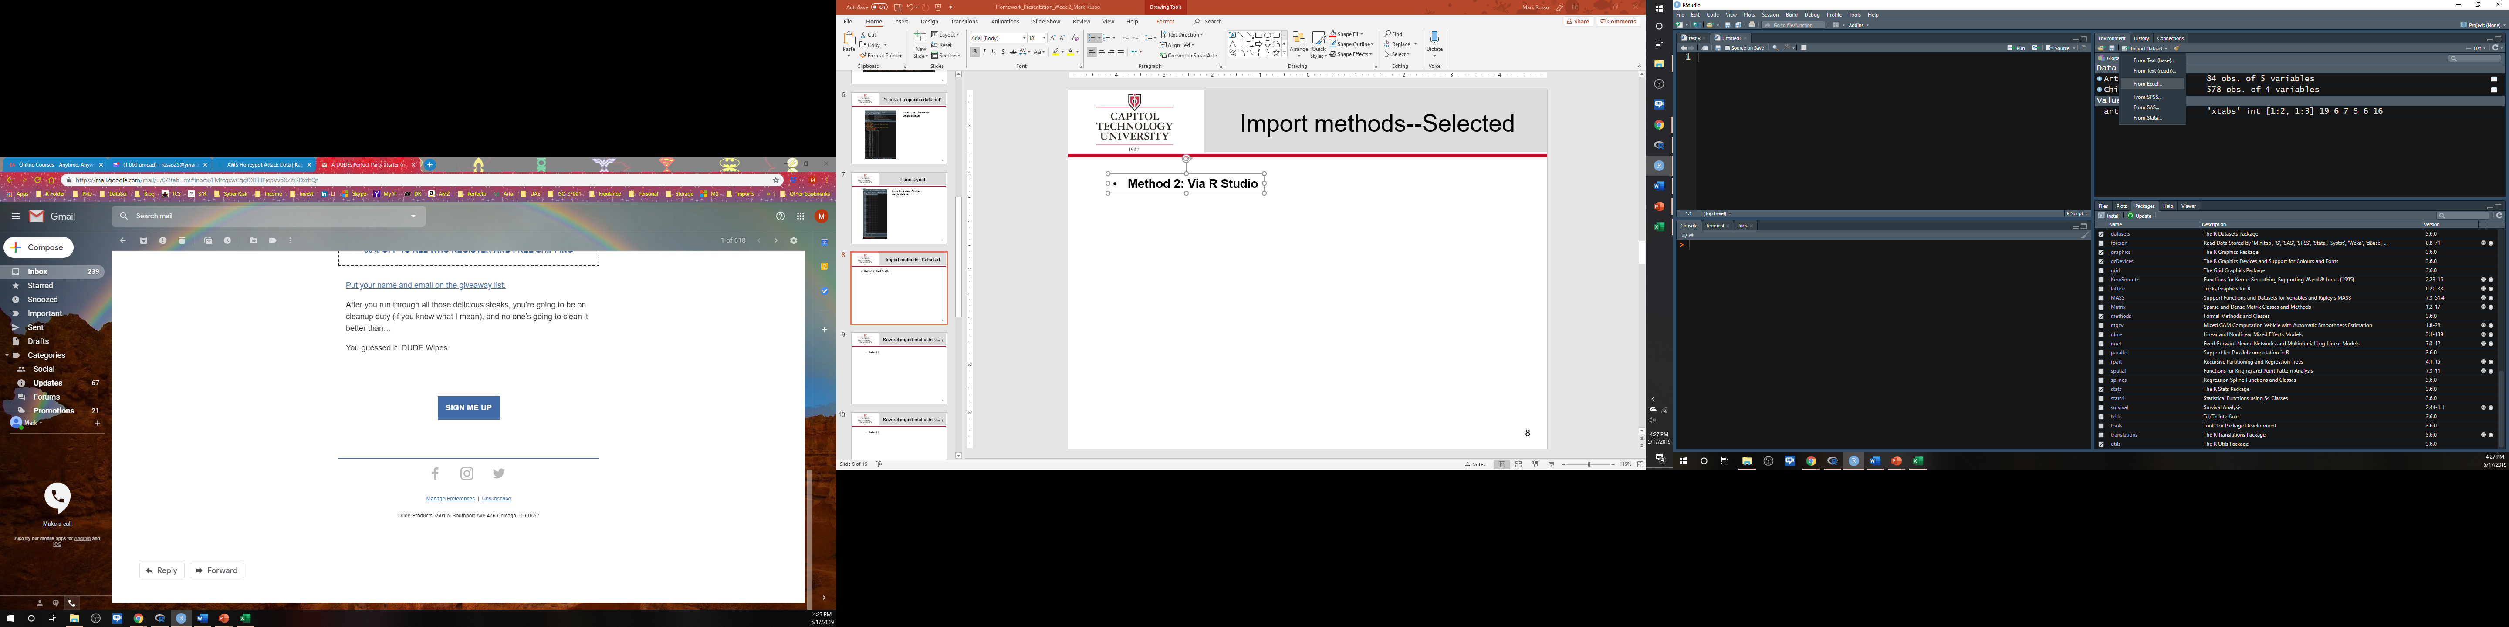
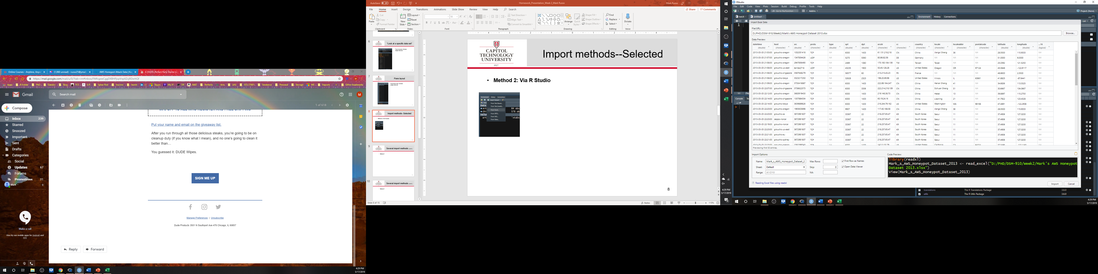
Import methods— Selected data set
Method 2: Via R Studio

Slide 13
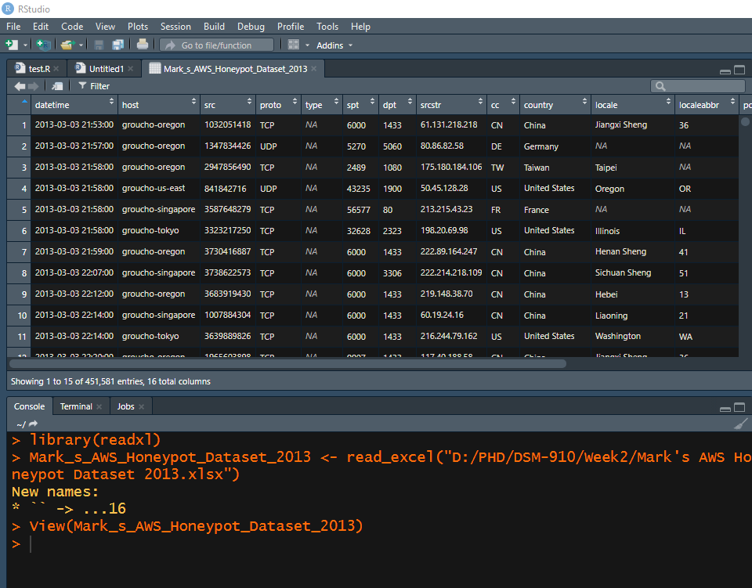
Import methods— Selected data set
Method 2: Via R Studio (cont.)

Slide 14
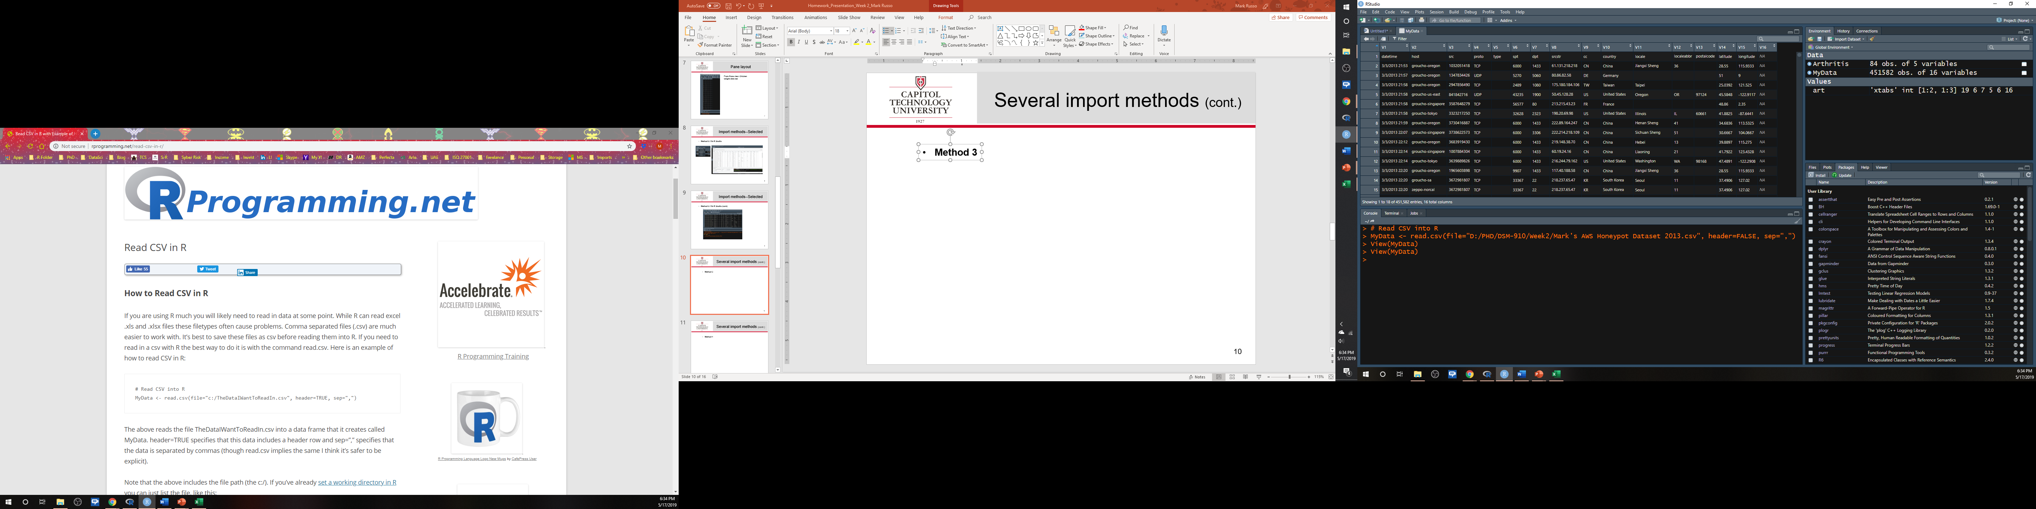
Import methods--Selected (cont.)
Method 3: “Read csv file into R via R”

Slide 15
Observations of R
Use IMPORT DATASET feature in R Studio where possible
Don’t forget when you copy a path in Windows with BACKWARD SLASHES you need to change them to FORWARD SLASHES
The full FILE path should always be surrounded by “QUOTES”
.csv easier to handle than XLS(X) (IMHO)
read.csv more reliable than read.table
R Programming.net. (n.d). How to read csv in R [Blog post]. Retrieved from http://rprogramming.net/read-csv-in-r/

Slide 16
Questions

